Slide 1
The evidence base on lifelong guidance A guide to key findings for effective policy and practice
Tristram Hooley (Reader in Career Development)

Slide 2
Lifelong guidance
“a continuous process that enables citizens at any age and at any point in their lives to identify their capacities, competences and interests, to make educational, training and occupational decisions and to manage their individual life paths in learning, work and other settings in which those capacities and competences are learned and/or used. Guidance covers a range of individual and collective activities relating to information-giving, counselling, competence assessment, support, and the teaching of decision-making and career management skills.” Council of the European Union (2008). Council Resolution on better integrating lifelong guidance into lifelong learning strategies.
Synonyms (or closely related terms) might include “career development”, “educational / vocational / career guidance”, “guidance and counselling”, “occupational guidance”, and “counselling”.

Slide 3
About the project
Production of a guide to the evidence base in lifelong guidance.
Primary audience – European policy makers.
Developed by the European Lifelong Guidance Policy Network (ELGPN).
Publication planned for summer 2014.

Slide 4
Building on the QAE Framework
ELGPN is involved in the ongoing piloting and testing of the Quality-Assurance and Evidence-Base (QAE) Framework.
The QAE Framework identifies a series of key elements that should be built into national systems to support quality service delivery and underpin the collection of evidence:
Practitioner competence.
Citizen/user involvement.
Service provision and improvement.
Cost-benefits to government.
Cost-benefits to individuals.

Slide 5
Key questions addressed
What is the relationship of lifelong guidance to public policy?
What is already known about the efficacy of lifelong guidance?
What is the evidence on guidance in learning?
What is the evidence on guidance for work?
What further evidence is needed on lifelong guidance?
What are the implications of the evidence base for policy and practice in lifelong guidance?

Slide 6
Challenges
Multi-disciplinary task (education, psychology, sociology, economics etc.)
Diverse literature (academic, policy focused, programme evaluations etc)
Range of places of publication
International
Multi-language
Multi-sectoral (schools, VET, HE, adult education, work, unemployed etc.)

Slide 7
Kirkpatrick’s levels of impact
Reaction. How do participants in guidance describe their experience? Did they enjoy it and do they feel their participation has been worthwhile?
Learning. Is it possible to quantify what has been learnt?
Behaviour. Do learners change their behaviour as a result of participating, e.g. working harder, actively exploring their careers, or entering a new course or job?
Results. Are there any observable impacts on systems, organisations or individuals, e.g. increased retention or academic attainment, improved transitions, increased career and life success?

Slide 8
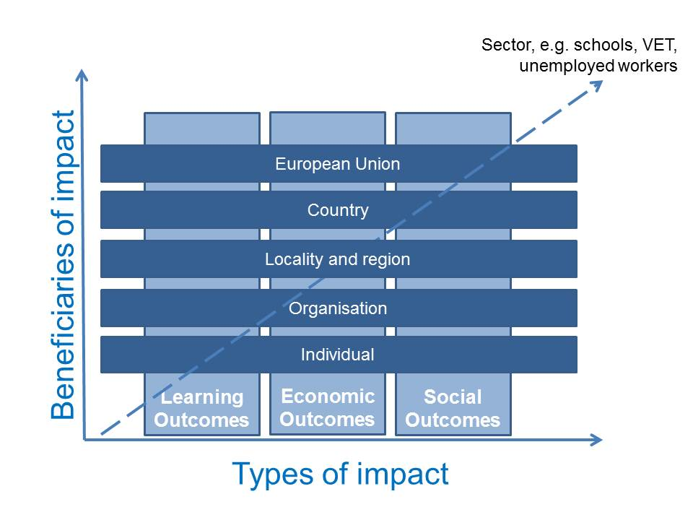
The impacts of lifelong guidance

Slide 9
Nine evidence-based principles for the design of lifelong guidance services
Focus on the individual | Support learning and progression | Ensure quality
Lifelong guidance is most effective where it is genuinely lifelong and progressive. Lifelong guidance is most effective where it connects meaningfully to the wider experience and lives of the individuals who participate in it. Lifelong guidance is most effective where it is able to recognise the diversity of individuals and to provide services relevant to individual needs. | Lifelong guidance is not one intervention, but many, and works most effectively when a range of interventions are combined. A key aim of lifelong guidance programmes should be the acquisition of career management skills. Lifelong guidance needs to be holistic and well-integrated into other support services. | The skills, training and dispositions of the practitioners who deliver lifelong guidance are critical to its success. Lifelong guidance is dependent on access to good-quality career information. Lifelong guidance should be quality-assured and evaluated to ensure its effectiveness and to support continuous improvement.

Slide 10
Nine evidence-based principles for the design of lifelong guidance services
Focus on the individual | Support learning and progression | Ensure quality
Lifelong guidance is most effective where it is genuinely lifelong and progressive. Lifelong guidance is most effective where it connects meaningfully to the wider experience and lives of the individuals who participate in it. Lifelong guidance is most effective where it is able to recognise the diversity of individuals and to provide services relevant to individual needs. | Lifelong guidance is not one intervention, but many, and works most effectively when a range of interventions are combined. A key aim of lifelong guidance programmes should be the acquisition of career management skills. Lifelong guidance needs to be holistic and well-integrated into other support services. | The skills, training and dispositions of the practitioners who deliver lifelong guidance are critical to its success. Lifelong guidance is dependent on access to good-quality career information. Lifelong guidance should be quality-assured and evaluated to ensure its effectiveness and to support continuous improvement.

Slide 11
Nine evidence-based principles for the design of lifelong guidance services
Focus on the individual | Support learning and progression | Ensure quality
Lifelong guidance is most effective where it is genuinely lifelong and progressive. Lifelong guidance is most effective where it connects meaningfully to the wider experience and lives of the individuals who participate in it. Lifelong guidance is most effective where it is able to recognise the diversity of individuals and to provide services relevant to individual needs. | Lifelong guidance is not one intervention, but many, and works most effectively when a range of interventions are combined. A key aim of lifelong guidance programmes should be the acquisition of career management skills. Lifelong guidance needs to be holistic and well-integrated into other support services. | The skills, training and dispositions of the practitioners who deliver lifelong guidance are critical to its success. Lifelong guidance is dependent on access to good-quality career information. Lifelong guidance should be quality-assured and evaluated to ensure its effectiveness and to support continuous improvement.

Slide 12
Nine evidence-based principles for the design of lifelong guidance services
Focus on the individual | Support learning and progression | Ensure quality
Lifelong guidance is most effective where it is genuinely lifelong and progressive. Lifelong guidance is most effective where it connects meaningfully to the wider experience and lives of the individuals who participate in it. Lifelong guidance is most effective where it is able to recognise the diversity of individuals and to provide services relevant to individual needs. | Lifelong guidance is not one intervention, but many, and works most effectively when a range of interventions are combined. A key aim of lifelong guidance programmes should be the acquisition of career management skills. Lifelong guidance needs to be holistic and well-integrated into other support services. | The skills, training and dispositions of the practitioners who deliver lifelong guidance are critical to its success. Lifelong guidance is dependent on access to good-quality career information. Lifelong guidance should be quality-assured and evaluated to ensure its effectiveness and to support continuous improvement.

Slide 13
Areas for development/further work
The evidence base is stronger in some sectors than in others. Notably it is strongest in relation to schools and young people.
The value of systematic national (or cross-national) frameworks for evidence gathering and monitoring.
Attending to the interests of policy makers and understanding the kinds of evidence that they like to see.
Broadening the range of methodologies and disciplinary bases that are used to investigate guidance.
Increasing the number of quantitative studies that focus on real world impacts (e.g. salary, grades, employment levels).
Use of control trial and longitudinal methods.
Further literature reviews and meta-analyses.

Slide 14
The lifelong guidance policy loop
Understanding what is known about the efficacy of lifelong guidance
Developing new policies and services
Implementing new policies and sevices
Monitoring implementation and checking efficacy

Slide 15
Conclusions
There is an extensive evidence-base that supports lifelong guidance.
This evidence base is international, multi-disciplinary, multi-sectorial and includes the use of a range of different research methods and paradigms.
It is possible to derive principles from the evidence-base which can support the development of effective policy in the area.
The evidence-base in lifelong guidance is necessarily a work in progress. Both governments and researchers need to commit to its ongoing development.

Slide 16
About the ELGPN
The European Lifelong Guidance Policy Network aims to assist the European Union (EU) Member States (and the neighbouring countries eligible for the EU Lifelong Learning Programme) and the European Commission in developing European co-operation on lifelong guidance in both the education and the employment sectors.
The ELGPN currently consists of 31 member countries.
ELGPN Finnish Institute for Educational Research University of Jyväskylä P.O. Box 35 FI-40014 University of Jyväskylä Finland email: elgpn(at)jyu.fi web: http://www.elgpn.eu

Slide 17
Tristram Hooley
Reader in Career Development
International Centre for Guidance Studies
University of Derby
http://www.derby.ac.uk/icegs
t.hooley@derby.ac.uk
@pigironjoe
Blog at
http://adventuresincareerdevelopment.wordpress.com

